Slide 1
Product Recommendation (Cosine Similarity)
By:
Aakarsh Sagar
Ajay Rawtani

Slide 2
Agenda
Research Question
Importance
Description of Data-set
Exploratory Data Analysis (EDA)
Cosine - The Math
Live
Conclusion

Slide 3
Research Question
Exploratory Data Analysis:
What are the top selling products in store?
What are the revenue trends and is it cyclical?
What is the mix of unique and repeat customers?
Does cosine similarity facilitate the recommendation of additional items based on user similarity?
Does cosine similarity facilitate the recommendation of additional items based on item similarity?

Slide 4
Importance of Cosine Similarity
Cosine similarity serves as a fundamental measure in various real-world applications.
Its ability to capture the semantic similarity between vectors makes it a valuable tool in data analysis, pattern recognition, and decision-making processes.
Uses:
Search engines: keyword vector and document vector similarity
Document Analysis: comparison of text based on their semantic similarity
Collaborative Filtering: comparing user-item interaction vectors with similar items
Image Processing: representing images as feature vectors
Dimensionality Reduction: transform high-dimensional data into lower-dimensional representations while preserving semantic relationships
ChatGPT!!!

Slide 5
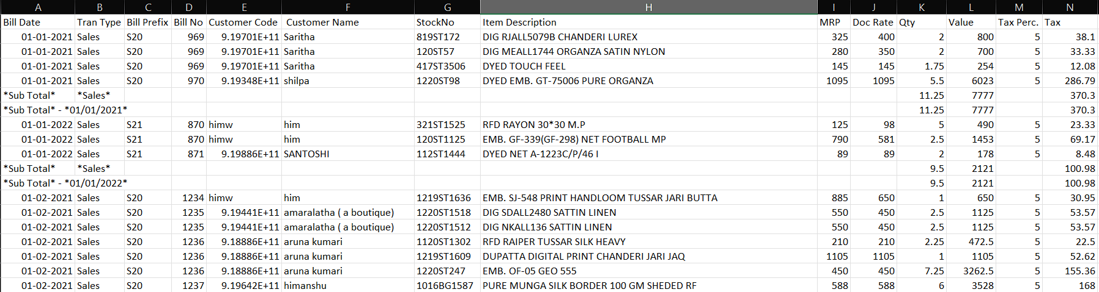
Description of Data-Set
Primary Data-set
Women's Boutique/Fabric Store – focus on Fabric Store
Rows – 8897, 14 columns (pre-clean)

Slide 6
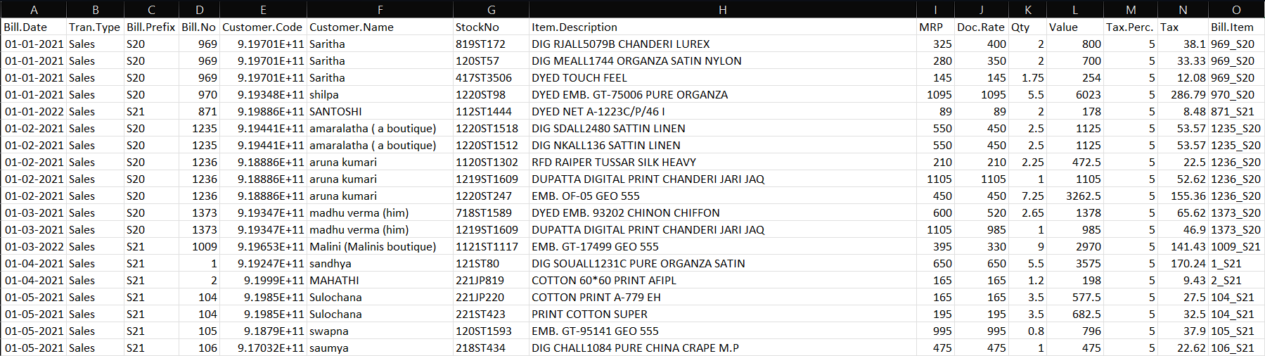
Description of Data-Set
Primary Data-set
Women's Boutique/Fabric Store – focus on Fabric Store
Rows – 6309, 14 columns (post-clean)

Slide 7
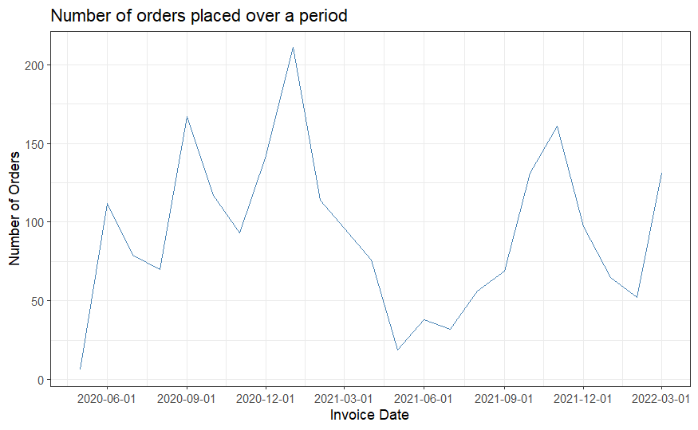
Exploratory Data Analysis

Slide 8
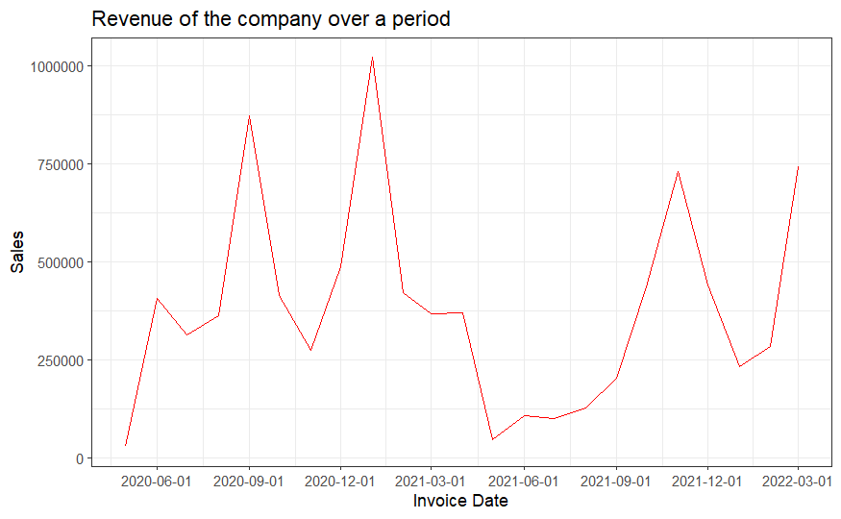
Exploratory Data Analysis

Slide 9
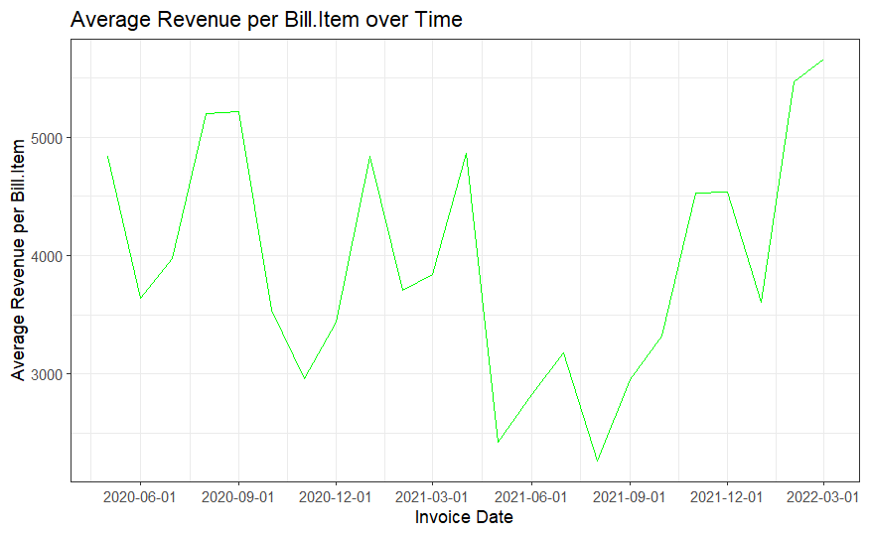
Exploratory Data Analysis

Slide 10
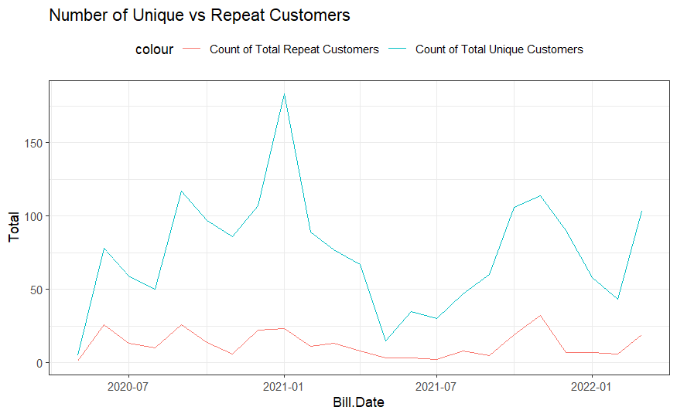
Exploratory Data Analysis

Slide 11
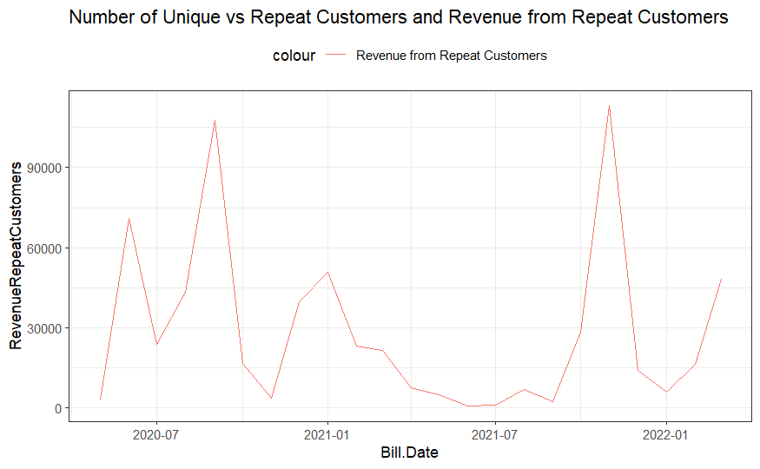
Exploratory Data Analysis

Slide 12
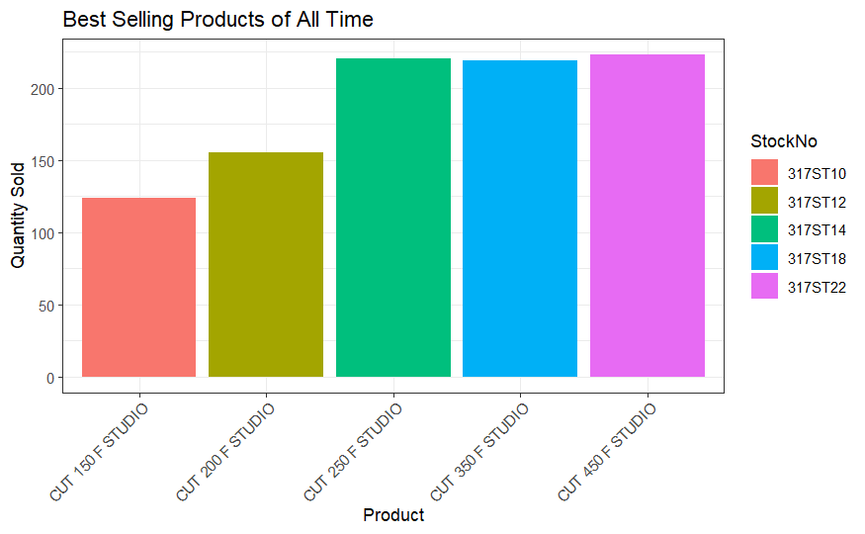
Exploratory Data Analysis
Notes:
Qty in meters

Slide 13
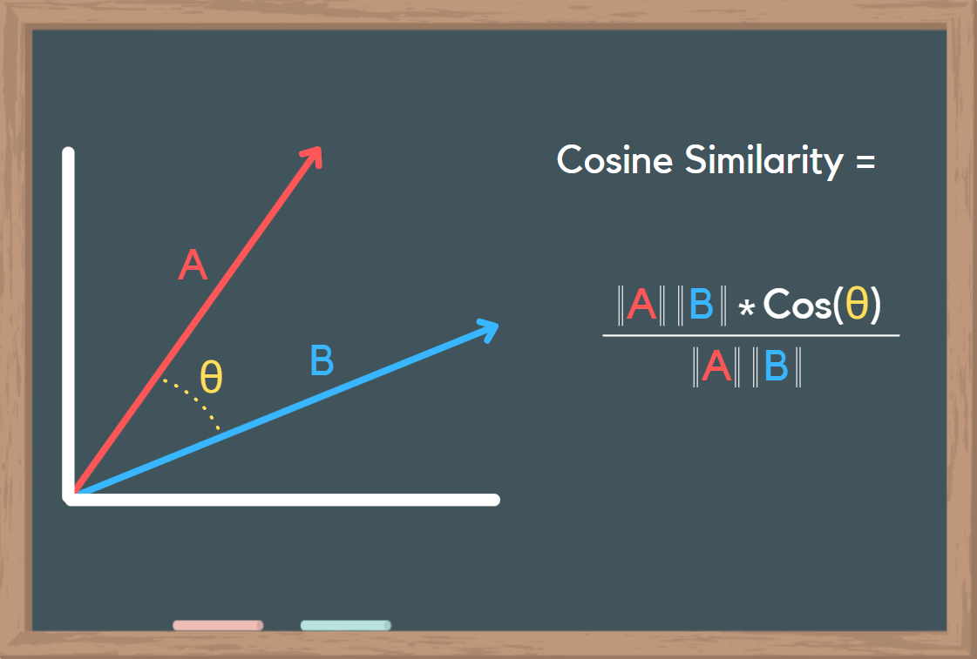
Cosine – The Math

Slide 14
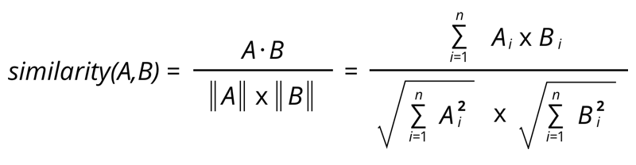
Cosine – The Math
Notes:
Show the math calculation

Slide 15
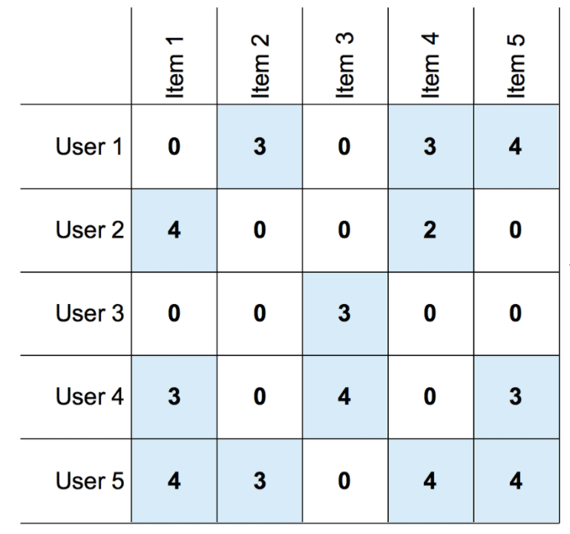
Cosine – The Math
Notes:
Show the math calculation

Slide 16
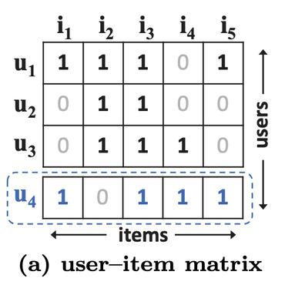
Cosine – The Math
Notes:
Show the math calculation

Slide 17






LIVE Example

Slide 18
Conclusion
Exploratory Data Analysis:
The analysis revealed that the top selling products in the store
The revenue trends show a cyclical pattern
Most customers are unique buyers, smaller proportion of repeat customers. Need a strategy to improve this
Cosine similarity effectively enables the recommendation of additional items based on user similarity, enhancing personalized recommendations.
Cosine similarity facilitates accurate item recommendations by leveraging item similarity, enhancing the relevance and diversity of suggested items.

